Slide 1

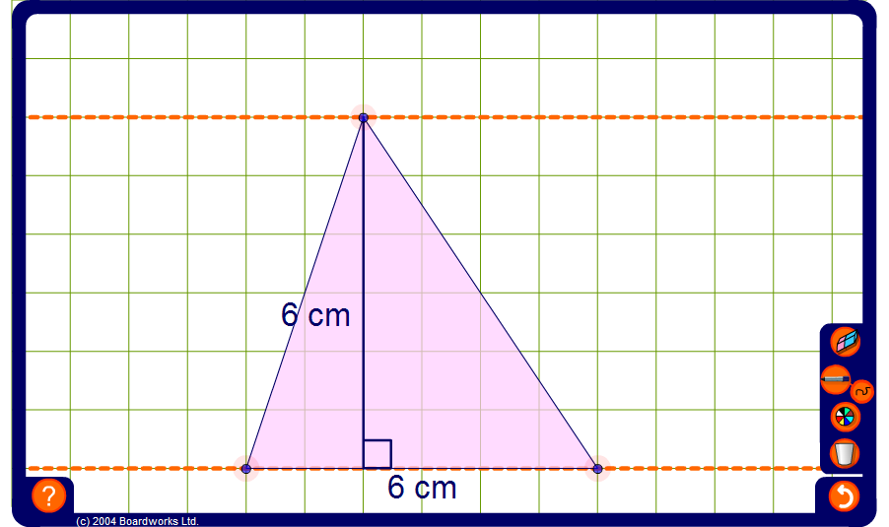


Area of a triangle
Notes:
Use this activity to deduce that the area of any triangle can be found by multiplying the length of the base by the perpendicular height.
Start with a right-angled triangle. Modify the triangle while keeping the length of the base and the height constant. Set the pen tool to draw straight lines and use it to draw a rectangle around the triangle. Ask pupils to use this to find the area of the triangle.
Repeat for a variety of triangles.

